Slide 1
CTS2 Development Framework Implementation Technical Overview
Scott Bauer, Cory Endle
HL7 Working Group Meeting
May 9th, 2013

Slide 2
Pre-tutorial House Keeping
If you wish to follow along with the interactive demos …
you’ll need a laptop and the tech stack and set up noted in the requirements document
This will need to be done before the tutorial starts
Instructions are in the requirements document here:https://github.com/hsbauer/cts2-example-service/archive/master.zip

Slide 3
Who is this Tutorial for?
Software developers, technical programmers, information architects, health informaticists, technical analysts
Should know how to implement the CTS2 technical framework specification at the end of this tutorial

Slide 4
What do I Need to Know as a Developer
Introduction to CTS2 recommended
Some knowledge of UML, CTS2 Specification, XML, JSON, REST required for full implementation
Java and JavaScript will be helpful for some of the examples
Command line Maven, Python and Unix/Linux may be helpful as well

Slide 5
Overview
CTS2 is a standard for the query, interchange and update of terminological resources
This tutorial will provide technical implementers with guidance for the implementation of the standard

Slide 6
Terminology Services
Terminologies:
A list of unique terms and a set of properties helps define our common context for a term.
Like a dictionary
The way we know how to use terms is more complex:
Classifications
Synonyms
Unstated relationships

Slide 7
Terminology Services
Awareness of what is not in a dictionary is a “way of knowing” (This is sometimes called ontology)
This is often built in to complex terminologies
A terminology service provides the structure
For using this way of knowing about the entities in service
For dealing with updates, versioning, history and other administrative functions

Slide 8
How to Approach the Specification
The specification is designed for modular implementation. You do not need to implement the entire specification!
Choose your implementation strategy based on local requirements, not to include a broad spectrum of the specification

Slide 9
Modular Specification Implement / use what you need
Code System Catalog Entry and Code System Version Catalog Entry
Entity Description and Association
Value Set Catalog, Value Set Definition and Resolved Value Set
Map Catalog Entry, Map Version
Concept Domain, Concept Domain Binding
Statement
Notes:
----- Meeting Notes (1/4/13 15:42) -----
Resolved Value Sets are useful if the original code system doesn’t exist. Can be passed around, shared. Contents of the resolved value set can’t be freshly updated from the original code system.
Statement provides support for some of the structure of how we know about the use of language particularly as it may relate to those frameworks that support semantic definition of the same including OWL/RDF

Slide 10
Modular Functionality Implement / use what you need
Read
Query
Import
Export
Update
Maintenance
History
Temporal
Notes:
Read: Read a specifically identified element’s contents
Query: Query given particular parameters, restrictions, search algorithms. Includes the ability to import or export content.
Update: the ability to validate load sets of changes into the service that updates its content
History – the ability to determine what changes have occurred over stated periods of time
Maintenance – the ability to create and commit sets of changes (May include deletes)
Temporal – the ability to ask questions about the state of the service at a given point in the past (or future).

Slide 11
Every Module Has:
Formal Information Model in UML
Defines the resource, how it is identified and what information it contains
Formal Computational Model in UML
Defines operations that are available for each functional (read, query, import, …) profile

Slide 12
Every Module Also Has
XML Schema representation of the Information Model
WADL rendering of Computational Model
Defines the URLs + operations (GET, PUT, POST, REMOVE) that implement the computations
WSDL rendering of Computational Model

Slide 13
Combined they provide a set of rules that:
Describe (some of) what can be said about various aspects of terminologies
Provide a straight-forward format for structuring the information
Provide rules for publishing, querying, exchanging and updating information in a distributed, federated environment

Slide 14
CTS2 in a nutshell
A set of XML Schemas for:
Code Systems, Maps, Value Sets and Concept Domain Bindings
A set of URL formation rules for:
Reading, Querying, Importing and Updating the XML Documents
A set of rules for representing XML in JSON, RDF, Java, Python, …
Notes:
It is a primarily REST based architecture. And you will see how this architecture helps define the modular nature of the specification.

Slide 15
CTS2 Implementation PLANNING AN IMPLEMENTATION

Slide 16
How do I plan an implementation?
Ask the following questions:
Do I need to implement a terminology service of my own?
Do I need unique content?
Do I need unique services from the content?
Can I adequately map the content into the CTS2 Model or do I need expert help?
Notes:
That is, do you have a terminology that is not currently represented in a current service.
Does that service provide the functions you need to get something done.

Slide 17
How do I plan an implementation? CTS2 Service
A persisted Terminology
CTS2 doesn’t specify how this is done
It may require wrapping an existing terminology service
Providing a mapping and a bridge for legacy technology
Or creating a direct implementation of CTS2 over a database
Starting from scratch against a (set of) persisted terminologies.

Slide 18
How do I plan an implementation? Are You Consuming Terminology Content?
If so what services do I need from the terminology service:
Do I want to search for terminology entities?
Do I need value sets for research forms?
Do I need to map from one terminology to another?
Do I need to traverse from a specific term to a more general one. Or establish term classification siblings? Semantic types?

Slide 19
Ways to Implement
Service implementers may want to implement a CTS2 Development Framework (DF) service plugin (This isn’t required)
CTS2 consumers will want to implement a REST/JSON, REST/XML or SOAP client
Notes:
References for cts2 informatics, rest api, and development framework

Slide 20
Tutorial Overview Where to Start
We’ll choose CTS2 modules that can serve a fairly wide set of use cases:
CodeSystemCatalogEntry, Entity Description, Value Sets, Associations
And use the same model elements to access code system entities, value sets, versions of code systems, and the relations tying entities together
Create a service plugin based on the CodeSystemCatalog model element
Note that these are a small part of the API
Notes:
----- Meeting Notes (1/7/13 14:44) -----
This model element needs to become the codesystem.
Get rid of associated children.

Slide 21
CTS2 REST Client API

Slide 22
CTS2 REST Client API
CTS2 design is based on REST architecture:
This shapes method calls and naming conventions
A directory groups summarized objects, such as code systems or entities represented as a catalog of these items
Read services generally are looking for a unique identifier for input
Resource links further define many of the returned values

Slide 23
Interactive Demo: CTS2 REST Client API
The focus will be on read and query module functions
Entity, code system(s), code system versions, associations and value sets to comprise the examples
REST calls will be to the various CTS2 compatible REST implementations

Slide 24
CTS2 Rest Client API
There is a pattern for building some basic REST calls in CTS2
<Base URL>/ + codesystems
<Base URL>/ + codesystemversions
<Base URL>/ + valuesets
Returns a catalog contained in a directory of entries that have individual summaries for each element

Slide 25
CTS2 Rest Client API
With some preparation to the base URL, similar directories of more granular elements in the terminology service can be retrieved.
<Base URL>/ + codesystem/ + <code system name>/
+ version/ + <version>/ + entities

Slide 26
CTS2 REST Client API
How do we know what code systems are at a service?
Start by querying the code systems
http://informatics.mayo.edu/cts2/rest/codesystems
This returns a directory, or list of summaries of the code systems on that service

Slide 27
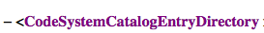
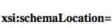
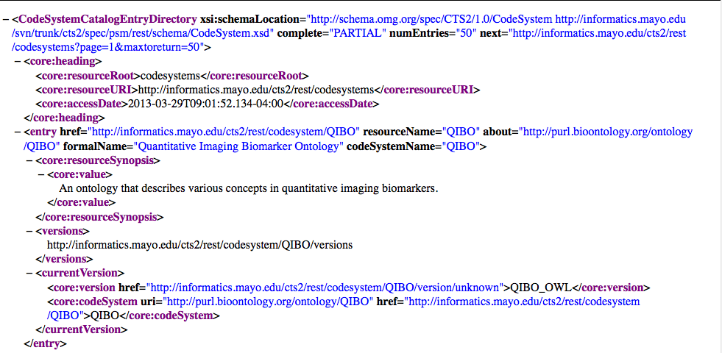
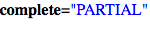
CTS2 REST Client API

Slide 28
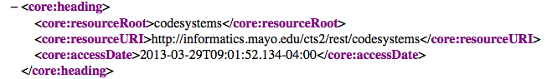
CTS2 REST Client API

Slide 29
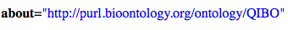
CTS2 REST Client API

Slide 30
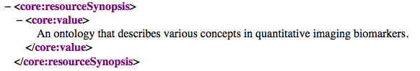
CTS2 REST Client API

Slide 31
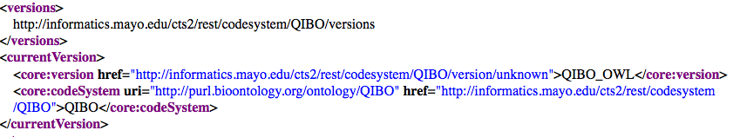
CTS2 REST Client API

Slide 32
CTS2 REST Client API
Review:
There is a similar structure for value sets and code system versions returned for CTS2 REST calls
You can reconstruct your last call from the heading
Depending on the Service, some XML tag content and attributes can be used to filter queries

Slide 33
CTS2 REST Client API
Review continued:
URLs exist that link other resources
Parsed values and links can be used to determine the number of values on the page and whether you can page for another set of values
Links and values exist to either help you build a REST call or provide you with a link to further define the resource

Slide 34
CTS2 REST Client API
What does this mean?
Users can both “Read” and “Query” a code system or any other entry that is cataloged in a directory
The listing of entries can each be read by their “resourceName” or queried by their global identifier or “URI” using a REST call

Slide 35
CTS2 REST Client API
And that queries can be done using filters:
By any attribute or tag supported as a filter in the service. This may include a terminology name, ontology Id, or description
And may use matching algorithms such as “contains” or “exact match”

Slide 36
CTS2 REST Client API
Building the REST:
<Base URL>/codesystem/<resourceName>
<Base URL>/codesystembyuri?<uri>
<Base URL>/codesystems? +
matchvalue=<value>& +
filtercomponent=<element to filter>
…. more

Slide 37
CTS2 REST CLIENT API
<Base URL>/codesystems?page=<page no>
<Base URL>/codesystems? +
page=<page no>& +
maxtoreturn=<number of entries>

Slide 38
CTS2 REST Client API
Walking through the set of entries in a catalog a user can cache all resourceNames and read with certainty the terminology associated with that resource name. Where MedDRA is MDR we call:
http://informatics.mayo.edu/cts2/rest/codesystem/MDR
Notes:
Add some screen shots

Slide 39
CTS2 REST Client API
Similarly a name is matched against the abbreviated ontology designation in this query of the code system
http://informatics.mayo.edu/cts2/rest/codesystems?matchvalue=MedDRA&filtercomponent=resourceSynopsis
Where matchvalue is the text to match and resourceSynopsis is the name field to match
Notes:
Add some screen shots

Slide 40
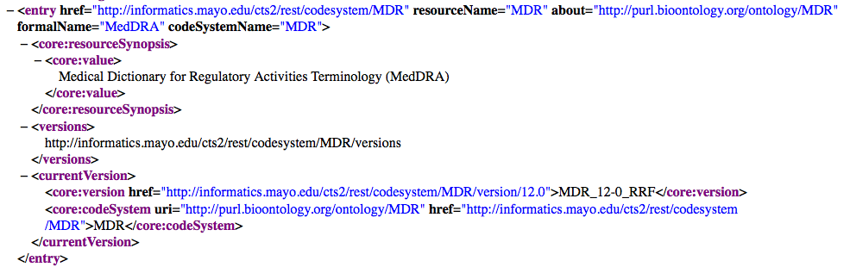
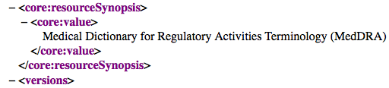
CTS2 REST CLIENT API
Searchable fields in the CodeSystemDirectoryEntry

Slide 41
CTS2 REST Client API
Review:
<Base URL>/codesystems? +
matchvalue=<value to match>& +
filtercomponent=<element to filter>

Slide 42
CTS2 REST Client API
A codesystemversions query has a similar query interface for getting all the versions of all the code systems on a given service
http://server root/codesystemversions
A more likely use case might be to get all versions of a given code system:
http://informatics.mayo.edu/cts2/rest/codesystem/LNC/versions

Slide 43
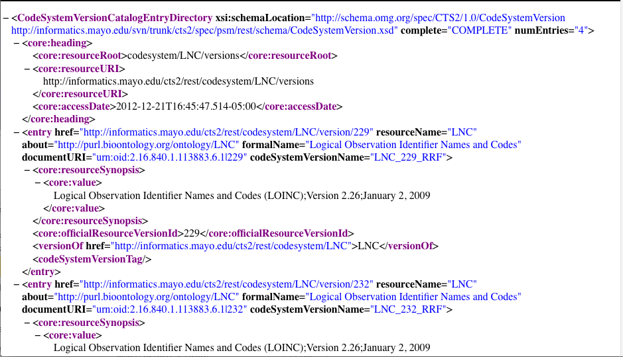
CTS2 REST Client API

Slide 44
CTS2 REST Client API
Review:
Retrieve the smaller set of versions
<Base URL>/codesystem/<code system id>/versions
Use the href of the version designation to return the desired version

Slide 45
CTS2 REST Client API
The href happens to be the same REST call otherwise used for the Code System Version Read function:
http://informatics.mayo.edu/cts2/rest/codesystem/LNC/version/232
This is a fairly consistent pattern. Entries contain URLs to another resource and in this case that resource is what is also returned by a similar read call

Slide 46
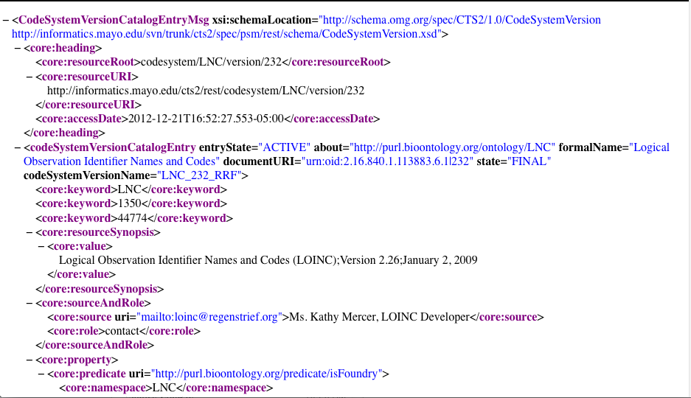
CTS2 REST Client API

Slide 47
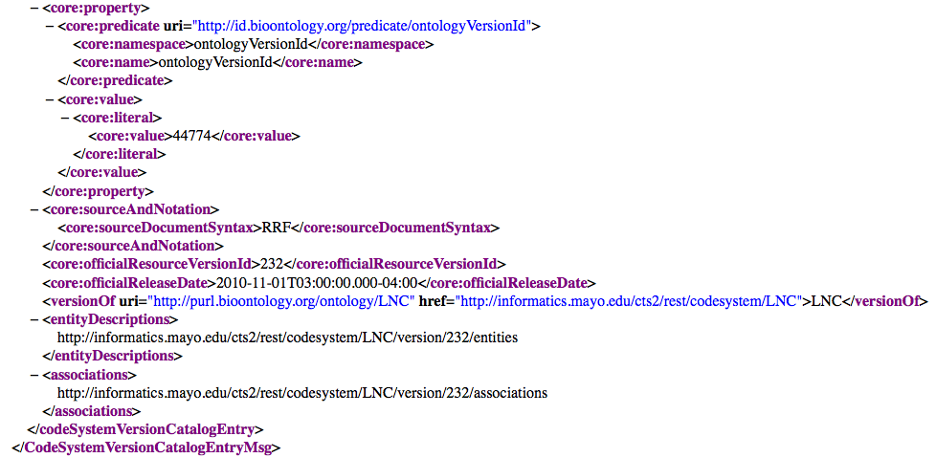
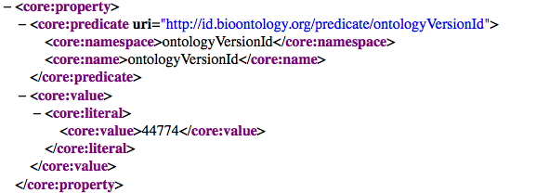
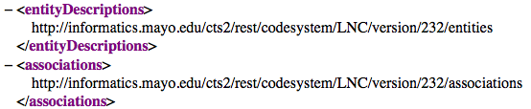
CTS2 REST Client API

Slide 48
CTS2 REST Client API
Review -- Retrieve versions of code Systems:
<Base URL>/codesystemversions
<Base URL>/codesystem/<code system id>/versions
<Base URL>/codesystem/<code system id>/version/<version id>

Slide 49
CTS2 REST Client API
Most users may just want to get an entity (a concept) by text match from a vocabulary service.
http://informatics.mayo.edu/cts2/rest/entities?matchvalue=swelling
Or they may want to get an entity from a particular version of a particular code system:
http://informatics.mayo.edu/cts2/rest/codesystem/LNC/version/232/entities?matchvalue=Cefoperazone
Notes:
When this is done without a filter component it defaults to resourceSynopsis

Slide 50
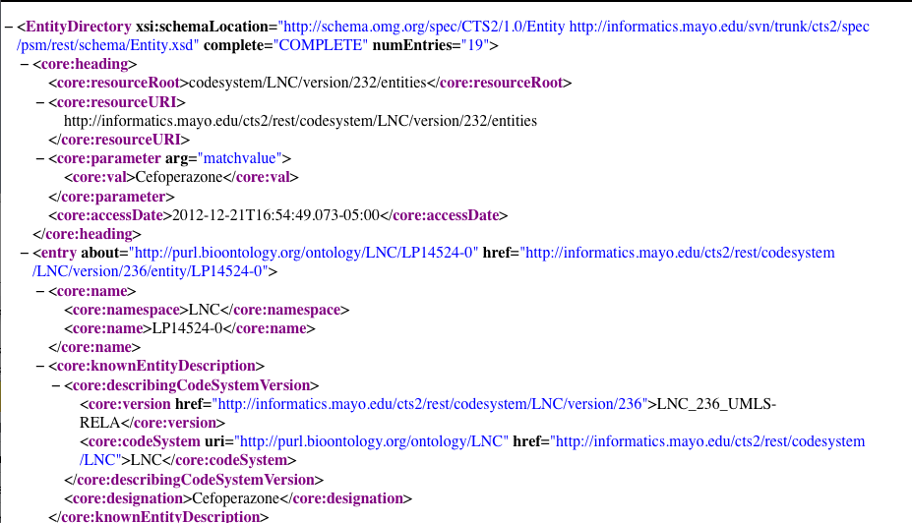
CTS2 REST Client API

Slide 51
CTS2 REST Client API
Having chosen a desired entity from that list we can resolve the full entity with an entity read:
http://informatics.mayo.edu/cts2/rest/codesystem/LNC/version/232/entity/100-8

Slide 52
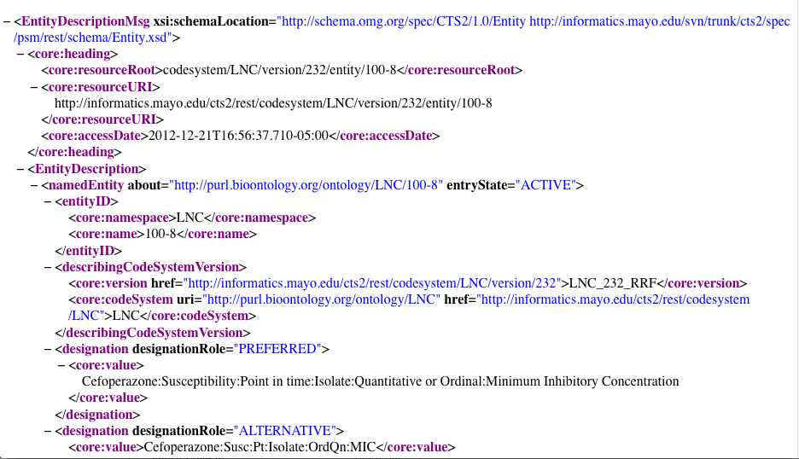
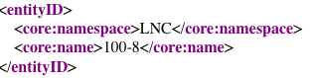
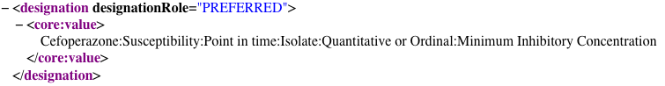
CTS2 REST Client API

Slide 53
CTS2 REST Client API
Review:
<Base URL>/entities
<Base URL and code system version>/ +
entities?matchvalue=<text to match>
<Base URL and code system version>/ +
entity/<entity name tag contents>

Slide 54
CTS2 REST Client API
Review:
<Base URL>/entities
<Base URL and code system version>/ +
entities?matchvalue=<text to match>& +
matchalgorithm=<match algorithm name>

Slide 55
CTS2 REST Client API
This lays the foundation for a likely use case. Starting from the code systems:
Display available code systems to user
User chooses code system(s)
Display versions to user
User chooses code system version
Display text match for concept search
User initiates text search and makes choice from matches (Final result is a readable entity display)

Slide 56
CTS2 REST Client API
Alternatively:
Display text match field to user
User enters text match
Display list of entity matches
User chooses match
Display selected user friendly entity attributes and properties to user

Slide 57
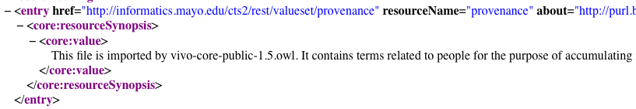
CTS2 REST Client API Value Sets
Using valueset and valuesets and resolvedvalueset API’s:
What value sets are on the service:
http://informatics.mayo.edu/cts2/rest/valuesets
<Base URL>/valuesets
<Base URL>/valueset/<resourceName>

Slide 58
CTS2 REST Client API Value Sets
Resolving a value set (adding the resolution parameter):
http://informatics.mayo.edu/cts2/rest/valueset/provenance/resolution
<Base URL>/valueset/<resourceName>/resolution

Slide 59
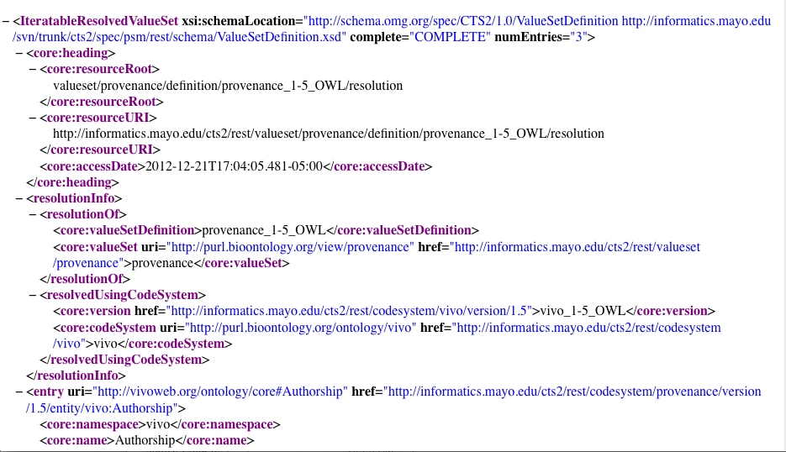
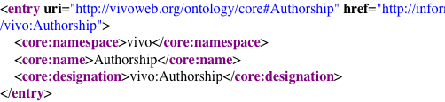
CTS2 REST Client API Value Sets

Slide 60
CTS2 REST Client API Value Sets
Getting the resolved value set objects:
http://informatics.mayo.edu/cts2/rest/resolvedvaluesets
Resolution using the href value from these results gives direct access to the resolved value set.
<Base URL>/resolvedvaluesets
Notes:
Resolved value sets are a select set of value sets that are resolved and persisted on the service.

Slide 61
CTS2 REST Client API Value Sets
Review:
<Base URL>/valuesets
<Base URL>/valueset/<resourceName>
<Base URL>/resolvedvaluesets
Notes:
Resolved value sets are a select set of value sets that are resolved and persisted on the service.

Slide 62
CTS2 REST Client API Associations
For many terminologies you don’t want to page through the entire set of associations but you can if you want:
http://informatics.mayo.edu/cts2/services/bioportal-rdf/codesystem/ICD9CM/version/ICD9CM-47178/associations
Normally graph traversal starts at some focus node and progresses from there.

Slide 63
CTS2 REST Client API Associations
Traversing from a focus node can start here:
http://informatics.mayo.edu/cts2/services/bioportal-rdf/codesystem/ICD9CM/version/ICD9CM-47178/entity/E008/subjectof
Where we find all the triples where entity “E008” is the subject

Slide 64
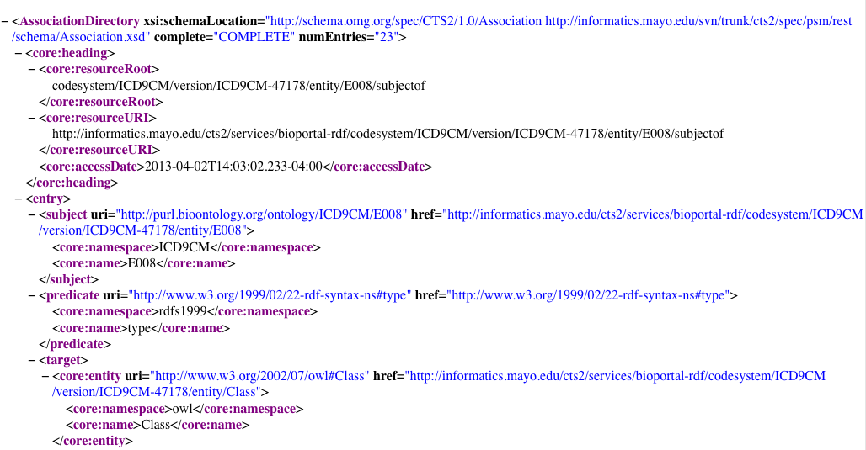
CTS2 REST Client API Associations

Slide 65
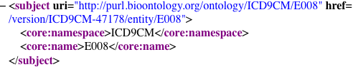
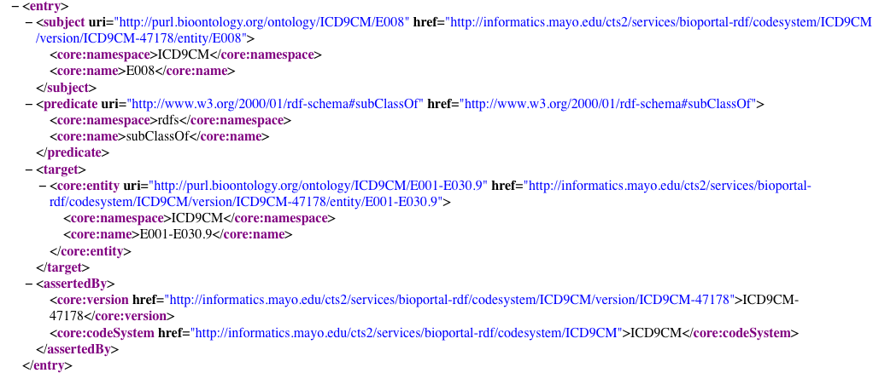
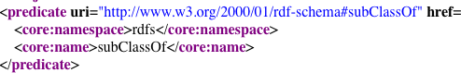
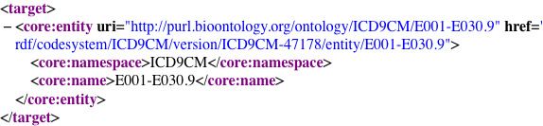
CTS2 REST Client API Associations

Slide 66
CTS2 REST Client API Associations
Similarly we can find all the triples where entity “E008” is the target
http://informatics.mayo.edu/cts2/services/bioportal-rdf/codesystem/ICD9CM/version/ICD9CM-47178/entity/E008/targetof

Slide 67
CTS2 REST Client API Associations
Using a designation of children or parents we can merely list the entities which have that designation without any of the metadata describing the relationship
http://informatics.mayo.edu/cts2/services/bioportal-rdf/codesystem/ICD9CM/version/ICD9CM-47178/entity/E008/children

Slide 68
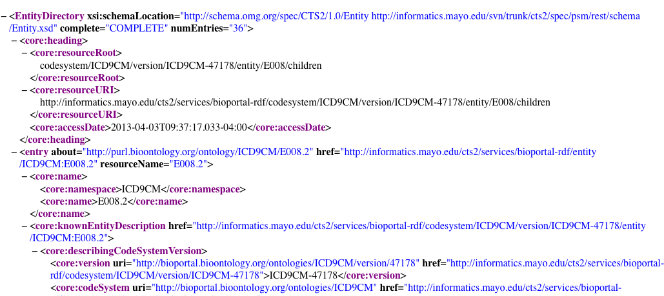
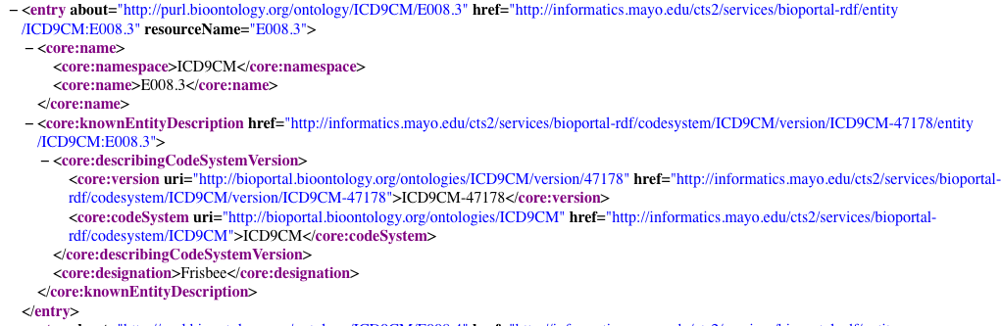
CTS2 REST Client API Associations

Slide 69
CTS2 REST Client API Associations
Ancestors and descendants of a given focus code provide some support for a transitive reasoning of what codes are related to each other a over a hierarchy of relations:
<Base URL code system version>/ +
entity/<entity id>/descendent
Resulting xml looks the same as children/parents REST call results – a list of entities

Slide 70
CTS2 REST Client API Associations
While relationships are described in subjectof and targetof calls, graph relationships can be shown by appending “graph” to any of the previous association type calls
<Base URL code system version>/ +
entity/<entity id>/subjectof/graph

Slide 71
CTS2 REST Client API Associations
Association Graph defines a flattened representation of the corresponding graph that is designed for manipulation and reassembly
every entry that occurs in the set of associations is assigned a unique number. These numbers are assigned in depth first order and, when both forward and reverse association traversal is supported, in the order of forward first followed by reverse

Slide 72
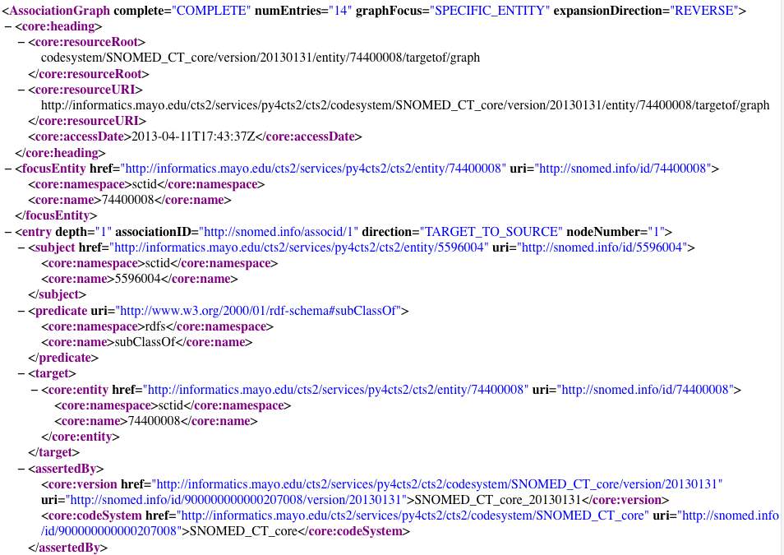
CTS2 REST Client API Associations
REVERSE
FORWARD
BOTH
SPECIFIC_ENTITY
TOP_NODE
BOTTOM_NODE
TARGET_TO_SOURCE
SOURCE_TO_TARGET
Notes:
TOP_NODE is the parent of all entities that don't have parents - it is intended to be the name of a virtual node - so children of TOP_NODE are all top level. Same for BOTTOM.

Slide 73
CTS2 REST Client API Associations
Notes:
associationID - the unique identifier of the association instance.

Slide 74
CTS2 REST Client API Associations
Review:
<Base URL and code system version>/ +
associations
<Base URL and codesystem version>/ +
entity/<entity code>/subjectof
<Base URL and codesystem version>/ +
entity/<entity code>/targetof

Slide 75
CTS2 REST Client API Associations
Review:
<Base URL and codesystem version>/ +
entity/<entity code>/children
<Base URL and codesystem version>/ +
entity/<entity code>/descendants
<Base URL and codesystem version>/ +
entity/<entity code>/children/graph
.

Slide 76
CTS2 REST Client API Associations
Scenario
An end user wants to to find instances of a class of medications
End user chooses a term in code system as a starting place.
A set of associations are displayed
User chooses an appropriate association and depth to resolve a hierarchy …

Slide 77
CTS2 REST Client API Associations
Scenario continued
A hierarchy is displayed with a set of instances at the bottom.
Example:
Analgesics is the top node, leaves are displayed that are dosages of a brand name aspirin and other analgesics.

Slide 78
CTS2 REST Client API Export Format
REST export formats:
Where supported, a choice of formats can be applied to the results. Formats could include such things as OWL, pipe delimited text, or JSON
<Base URL>/codesystems&format=<format>
http://informatics.mayo.edu/cts2/services/py4cts2/cts2/codesystems/?format=json

Slide 79
CTS2 REST Client API
Developer Strategies:
Parse initial XML for resourceName and construct REST queries
Parse the href from each set of queries and use the resulting XML to resolve further. (Remember each result has either data and possibly href(s) pointing to new resource options.)

Slide 80
CTS2 REST Client API Summary
Developers should now be able to text match search on CTS2 module attributes
Retrieve coed systems, entities, value sets, and associations
Page through large result sets
Follow href values to other module definitions as they are available
Notes:
----- Meeting Notes (1/4/13 15:42) -----
Break here

Slide 81
CTS2 REST Client API Summary of Technical Details
Reads on code systems and value set are constructed from the resourceName attribute
Reads on entity are constructed from the contents of the the name tag
Default queries (No filtercomponent applied) defaults to resourceSynopsis where present and designation in entities.
Notes:
----- Meeting Notes (1/4/13 15:42) -----
Break here

Slide 82
CTS2 Implementation
COMMAND LINE AND XSLT TRANSFORMS

Slide 83
CTS2 REST Client Command Line
Windows, Linux and Unix can pull in CTS2 XML via command line REST calls.
On Linux and Unix the curl command can be used to pull xml into a file where an application can process it and serve it up to a user.

Slide 84
CTS2 REST Client Command Line
For example:
curl http://informatics.mayo.edu/cts2/rest/valuesets > valuesets.xml
Redirects a CTS2 value set into an xml document where it could be served up on an eXist XML database or processed into a more user friendly file using a XSLT style sheet

Slide 85
CTS2 REST Client Command Line and XSLT
Exercise:
Use curl or a browser to get some CTS2 object in XML from a service
Use an XSLT transform to transform the values into an HTML representation

Slide 86
CTS2 REST Client Command Line and XSLT
Using Firefox open the following in tabs:
http://informatics.mayo.edu/cts2/rest/valuesets
http://markbucayan.appspot.com/xslt/index.html
And the two XSLT files in the example folder
Use the ValueSetCatalogEntryDirectory.xsl to transform the first XML page. Use the link to click through to an IterableResolvedValueSet and try the second XSL, IterableResVS

Slide 87
CTS2 REST Clients
PYTHON AND SCALA

Slide 88
REST Clients Tutorial Platform Independence
REST means platform independent clients
REST can be consumed by any client that can make http or https connections and parse XML or JSON
Python and Scala can both achieve this
In the example folders there is sample code for Python and Scala REST consuming clients
Note: Not an interactive demo

Slide 89
REST Clients Platform Independence: Python
Python, a C based scripting language, can create a simple REST client in a few lines of code
This example depends on a library not included in the regular Python distribution:
from restful_lib import Connection

Slide 90
REST Clients Platform Independence: Python
Create the connection:
conn = Connection("http://informatics.mayo.edu/cts2/rest")
reply = conn.request_get("/valuesets?format=json",
headers={'Accept':'application/json;q=1.0'})

Slide 91
REST Clients Platform Independence: Python
Test the response and print it:
if reply['headers']['status'] == '200':
print reply['body']
print eval(reply['body'])

Slide 92
REST Clients Platform Independence: Python
Here is a short, self-contained script that does a search on value sets matching the word “Sequence”:
conn = Connection("http://informatics.mayo.edu/cts2/rest")
print conn.request_get("/valuesets?matchvalue='Sequence'")['body']

Slide 93
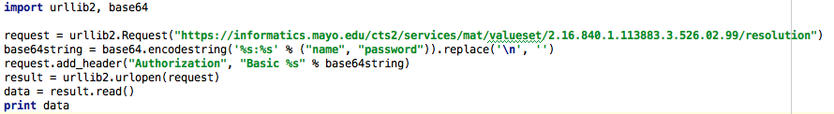
REST Clients Platform Independence: Python
Using a couple of integrated Python libraries you can also do authentication using https.
(Requires valid username and password)

Slide 94
REST Clients Platform Independence: Scala
Scala is a functional programming language that compiles to Java bytecode
As such it can reuse some of the libraries used in Java.

Slide 95
REST Clients Platform Independence: Scala
Import Java http and Scala input/output libraries:
import java.net.{HttpURLConnection, URL}
import io.Source
Create an executable Scala object:
object CTS2RestClient extends App{
}

Slide 96
REST Clients Platform Independence: Scala
Add some code to connect to the service:
val connection =
new URL("http://informatics.mayo.edu/cts2/rest/valuesets").openConnection().asInstanceOf[HttpURLConnection]

Slide 97
REST Clients Platform Independence: Scala
Get the input Stream:
val inputStream = connection.getInputStream
val src = Source.fromInputStream(inputStream)
Print it out:
src.getLines().foreach(println)

Slide 98
CTS2 Client Implementation Building Blocks and Examples

Slide 99
CTS2 UI Basics

Slide 100
CTS2 JavaScript Examples JSFiddle - Overview
We will use JSFiddle to work with the web related files
JSFiddle allows us to see all the files (CSS, JavaScript, and HTML) in one page and edit them
Changes are seen immediately
http://jsfiddle.net/

Slide 101
CTS2 JavaScript Examples The Basics
JavaScript and JSON
Quickly and easily:
Query and display a code system:
Browser
http://informatics.mayo.edu/cts2/rest/codesystem/SNOMEDCT?format=json
JavaScript
Notes:
JSON – JavaScript Object Notation - language independent --C, C++, C#, Java, JavaScript, Perl, Python, and many others.
JSON is built on two structures: Collection of name/value pairs (Objects) AND An ordered list of values.

Slide 102
CTS2 JavaScript Examples The Basics
Simple requirements:
URL
REST call that returns JSON object
Parse/display the JSON

Slide 103
CTS2 JavaScript Examples The Basics
CTS2 REST URL
$.getJSON(
"http://informatics.mayo.edu/cts2/rest/codesystem/SNOMEDCT?format=json&callback=?",
function( cts2JSON ) {
document.write(
cts2JSON.codeSystemCatalogEntryMsg.codeSystemCatalogEntry.codeSystemName);
});
JSON Return Object
Parse JSON to retrieve data

Slide 104
CTS2 JavaScript Examples The Basics – Code Systems
Quickly and easily:
Access a listing of codes systems
Access code system properties
http://jsfiddle.net/coryendle/yPC4K/

Slide 105
CTS2 JavaScript Examples The Basics – Value Sets
Quickly and easily:
Access a listing of value sets
Access value sets from different CTS2 services
Access value set properties
Access value set entities (resolved)
http://jsfiddle.net/coryendle/rLSUa/

Slide 106
CTS2 JavaScript Examples How to build from the Basics
Building blocks
We can use the simple calls as the foundation to create more complex UI widgets and applications
Several JavaScript UI Libraries available to create dynamic content:
jQuery
GWT
SmartGWT
Others

Slide 107
CTS2 UI Widgets and Application Examples

Slide 108
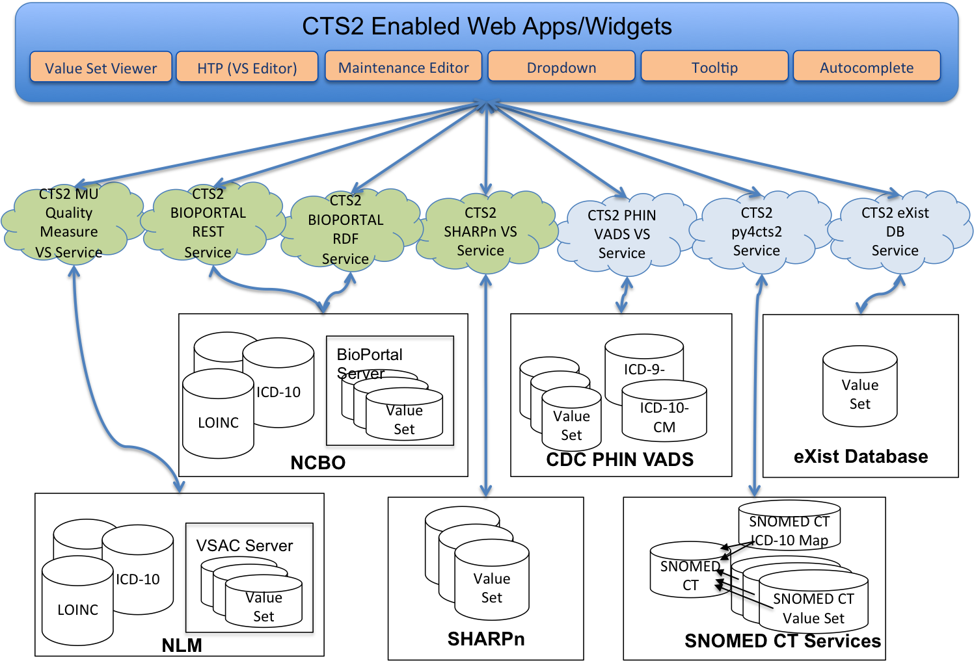
CTS2 Implementations Overview

Slide 109
Displaying CTS2 Content
We have developed several customizable widgets that can be added to a web page to present CTS2 content
Open source and available in GitHub:
https://github.com/cts2/

Slide 110
CTS2 Enabled UI Widgets Overview
Tooltips
jQuery tooltip widget used to display value sets and code systems when you mouse over text
Autocomplete
jQuery autocomplete widget used to suggest value sets as you type
Dropdown
jQuery example to fill a select (dropdown) with specific resolved value sets

Slide 111
CTS2 Enabled UI Widgets Demonstration
http://informatics.mayo.edu/cts2widgets/widgets.html
Features and customization points of each widget:
Ability to set the value set ID/code system ID to retrieve different values
Cascading Style Sheets (CSS) to change the look and feel
CTS2 parameterized values to customize the query
Notes:
Go to http://informatics.mayo.edu/cts2widgets/widgets.html

Slide 112
UI Widget: Tooltip

Slide 113
CTS2 Enabled UI Widgets Lab Exercise – Tooltip: Add a new tooltip
Retrieve a list of available value sets:
http://informatics.mayo.edu/cts2/rest/valuesets
Select any value set – resourceName
Example: skos
Notes:
* Using CTS2 Service for NCBO BioPortal REST service
Simple Knowledge Organization System (SKOS)

Slide 114
CTS2 Enabled UI Widgets Lab Exercise – Tooltip: Add a new tooltip
Look at the result of value set call:
http://informatics.mayo.edu/cts2/rest/valueset/skos$format=json
We will use the data returned here to populate our CTS2 tooltip widget

Slide 115
CTS2 Enabled UI Widgets Lab Exercise – Tooltip: Add a new tooltip
http://jsfiddle.net/coryendle/n9bWF/
Create a new tooltip for your value set ID
Add the HTML to display the tooltip with your value set ID
<p><a href="#" class="hint_vs" data-id="skos">SKOS</a> Value Set Demo.</p>
Select the “Run” button to test your changes.
Notes:
** Announce that we are getting code snippets from CTS2_advanced_tutorial_ui_links_and_code.docx

Slide 116
CTS2 Enabled UI Widgets Lab Exercise – Tooltip: Add a row
Update the tooltip to display another row of data. We will add the entryState status:
Find the following function:
function getValueSetTableInfo(valueSetJson)
Add another variable:
var entryState = valueSetJson.valueSetCatalogEntryMsg.valueSetCatalogEntry.entryState;

Slide 117
CTS2 Enabled UI Widgets Lab Exercise – Tooltip: Add a row
Add another HTML row:
"<tr><td class=\"noWrap\">Entry State:</td><td>" + entryState + "</td></tr>" +
Select the “Run” button to test your changes

Slide 118
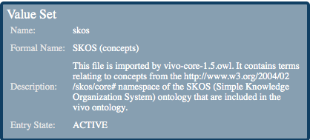
CTS2 Enabled UI Widgets Lab Exercise – Tooltip: Add a row
Now when you mouse over a value set ID, you will see an additional row called “Entry State” in the tooltip

Slide 119
UI Widget: Dropdown

Slide 120
CTS2 Enabled UI Widgets Lab Exercise – Dropdown: Country of Birth
We will create a dropdown to select a person’s country of birth
Retrieve a list of available value sets from CDC PHINVADS CTS2 service:
http://informatics.mayo.edu/cts2/services/phinvads/valuesets?maxtoreturn=100
Select the value set where:
valueSetName=“PHVS_BirthCountry_CDC”
Notes:
Center for Disease Control (CDC)
Public Health Information Network Vocabulary Access and Distribution System (PHINVADS)
http://www.cdc.gov/phin/tools/PHINvads/index.html

Slide 121
CTS2 Enabled UI Widgets Lab Exercise – Dropdown: Country of Birth
Look at the result of resolved value set call:
http://informatics.mayo.edu/cts2/services/phinvads/valueset/PHVS_BirthCountry_CDC/resolution?format=json
We will use the data returned here to populate our CTS2 dropdown widget

Slide 122
CTS2 Enabled UI Widgets Lab Exercise – Dropdown: Country of Birth
JSFiddle code:
http://jsfiddle.net/coryendle/bhTaD/
In the HTML code, we will add another dropdown to select the country of birth
After the code for the “Severity” dropdown, add the following line of code:
<br/><br/> Country of Birth: <select class="cts2-valueset(name : PHVS_BirthCountry_CDC;max:500)"></select>
Notes:
Explain the HTML and Javascript files –The ID passed from the HTML to the JS and the REST call

Slide 123
CTS2 Enabled UI Widgets Lab Exercise – Dropdown: Country of Birth
Select the “Run” button to test your changes
You will now see the Country of Birth dropdown:

Slide 124
CTS2 Web App Implementations
PUTTING IT ALL TOGETHER

Slide 125
UIs created for CTS2 Implementations CTS2 Value Set Viewer
Generic Value Set Browser/export
Uses the building blocks
Initially created for Meaningful Use (MU) Quality Measure Value Set Service to serve NLM value sets
Can view any CTS2 compliant value set service (NCBO,PHINVADS CDC,VSAC)
https://informatics.mayo.edu/vsmc/?showAll=true
Notes:
** Talk about Building Blocks **
Center for Disease Control (CDC)
Public Health Information Network Vocabulary Access and Distribution System (PHINVADS)
http://www.cdc.gov/phin/tools/PHINvads/index.html

Slide 126
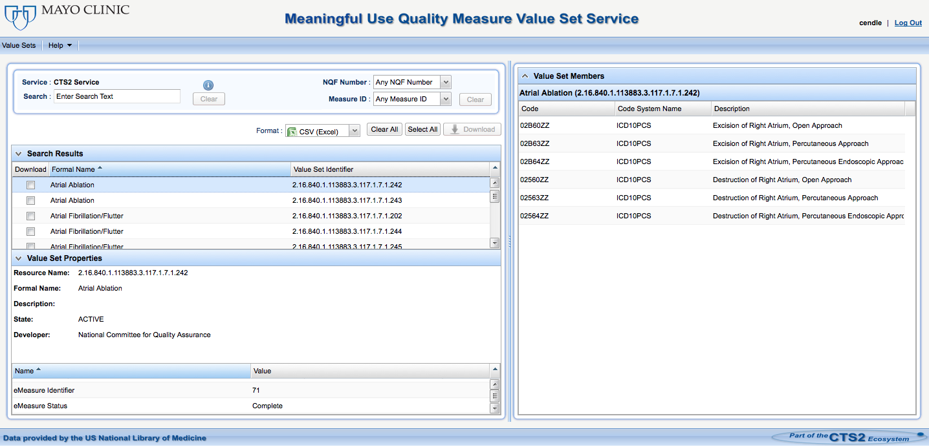
UIs created for CTS2 Implementations CTS2 Value Set Viewer
https://informatics.mayo.edu/cts2/services/mat/valuesets?&maxtoreturn=100
https://informatics.mayo.edu/cts2/services/mat/valueset/2.16.840.1.113883.3.464.0001.152/resolution
https://informatics.mayo.edu/cts2/services/mat/valueset/2.16.840.1.113883.3.464.0001.152

Slide 127
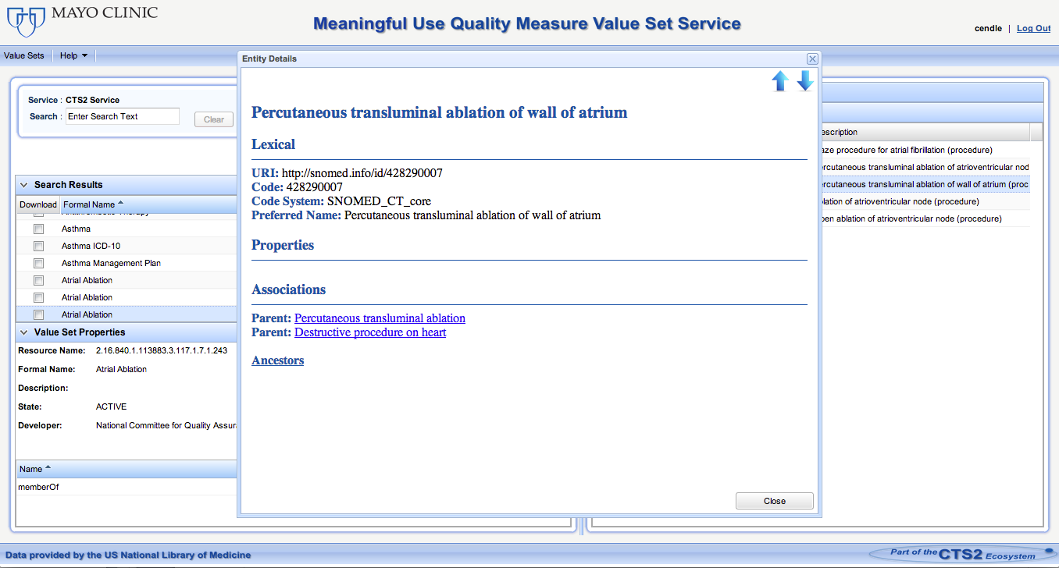
UIs created for CTS2 Implementations CTS2 Value Set Viewer
Using py4cts2 implementation to retrieve entities and their associations
Notes:
Py4cts2 implementation
Show Demo of Value Set Viewer after explaining
- talk about ancestors, children and decedents (py4cts2)
- XML button

Slide 128
Web Applications CTS2 Maintenance Editor
Application for managing CodeSystems, Entities, and Change Sets
Demonstration of CTS2 maintenance functionality
Currently in development
http://informatics.mayo.edu/exist/cts2/rest/editor/console
Notes:
To help get an understanding of the how the Maintenance Profile works (creating modules, Entries, and Change Sets and Versioning)

Slide 129
CTS2 Client Implementation Building Blocks and Examples
SUMMARY

Slide 130
UI and Widget Review
Quickly and easily retrieve CTS2 content
Using building blocks
Customizable UI widgets available to quickly utilize CTS2 content
Examples of web applications that utilized CTS2 service
Created with the building blocks
Open Source
Notes:
Open Source with Apache 2 license
http://www.tldrlegal.com/license/apache-license-2.0-%28apache-2.0%29

Slide 131
Questions

Slide 132
CTS2 Java REST Client

Slide 133
CTS2 REST Client Java
Create a new Maven project in Eclipse using cts2.rest as the group and artifact id
Check the box that allows you to make a simple Maven project (No Archetypes)
Create/use class in src/main/java with a main method
(Code is found in the cts2-example-service zip ValueSetClient.java)

Slide 134
CTS2 REST Client Java
Create a method called getValueSets with a return value of void.
public void getValueSets()
You’ll need some kind of REST URL to resolve:
String uri = "http://informatics.mayo.edu/cts2/rest/valuesets";
And convert to a Java URL
URL url;
try { url = new URL(uri);

Slide 135
CTS2 REST Client Java
Create a connection:
HttpURLConnection connection = (HttpURLConnection) url.openConnection();
Test it:
if (connection.getResponseCode() != 200) { throw new RuntimeException("Failed : The HTTP error code is : " + connection.getResponseCode()); }

Slide 136
CTS2 REST Client Java
Stream it into a buffered reader:
BufferedReader br = new BufferedReader(new InputStreamReader( (connection.getInputStream())));
Here the output can be printed:
String output;
System.out.println("Output from Server .... \n"); while ((output = br.readLine()) != null) { System.out.println(output); }

Slide 137
CTS2 REST Client Java
The normal use case for XML consumption is to marshal to java objects.
Create a new method: getValueSet()
We’ll make a REST call that returns JSON and consume it using some CTS2 specific code.
String uri = "http://informatics.mayo.edu/cts2/rest/valuesets?matchvalue=Sequence&format=json";

Slide 138
CTS2 REST Client Java
And add a request parameter to the connection: connection.setRequestProperty("Accept", "text/json");

Slide 139
CTS2 REST Client Java
We’ll handle the buffered output differently:
JsonConverter converter = new JsonConverter();
ValueSetCatalogEntryDirectory valuesetcat = converter.fromJson(builder.toString(), ValueSetCatalogEntryDirectory.class);
Uses CTS2 Development Framework classes to handle parsing and marshaling duties

Slide 140
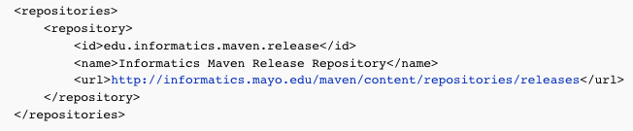
CTS2 REST Client Java
This will cause some compiling errors, so we’ll add some values to the maven project. First add a repository:
(From the CodeandPomSnippets file)

Slide 141
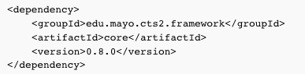
CTS2 REST Client Java
Then add a single dependency:
The CTS2 Development Framework solves a number of the parsing and marshaling problems so long as you marshal the XML or JSON into a CTS2 object.

Slide 142
CTS2 REST Client Java
Add code to print some output:
List<ValueSetCatalogEntrySummary> sum = valuesetcat.getEntryAsReference();
for(ValueSetCatalogEntrySummary s : sum){
System.out.println(s.getFormalName());
System.out.println(s.getCurrentDefinition());
System.out.println(s.getResourceName());
System.out.println(s.getValueSetName());
System.out.println(s.getHref());
}

Slide 143
CTS2 REST Client Java
And disconnect:
connection.disconnect();

Slide 144
CTS2 REST Client Java
Create a main method and run one of the methods:
public static void main(String[] args){
new ValueSetClient().getValueSet();
}

Slide 145
CTS2 REST Client Java
Simple REST clients can be duplicated in any number of implementation environments.
See details of more Java, Python, Scala and Unix based curl command implementations here:
http://informatics.mayo.edu/CTS2_V3/index.php/Value_Set_REST_API_and_Implementation_Examples

Slide 146
CTS2 Plugin Tutorial Overview

Slide 147
CTS2 Development Framework Providing a Toolset
REST HTTP URL bindings
CTS2 model as Java Beans
Various Builder pattern query building objects
CTS2 REST client
Manages JSON and XML parsing and Marshaling of either into CTS2 model objects
Plugin admin structure
A quick start on your own service

Slide 148
CTS2 Implementation
SERVICE PLUGIN TUTORIAL

Slide 149
CTS2 Plugins How are Development Framework Plugins Used?
A plugin can be used to add a service to the CTS2 Development Framework base.
Given a source terminology with it’s own data model and corresponding database schema
Map it into a set of CTS2 Model Objects and attach it to the framework where it can be served up in CTS2 REST
Notes:
What’s an example of a plugin.

Slide 150
CTS2 plugins How are Plugins Used?
How can a plugin be enabled within the CTS2 Development Framework?
Every plugin must implement the ServiceProvider Interface*
The jarred plugin will be uploaded to the stand alone CTS2 Development Framework server.
*edu.mayo.cts2.framework.service.provider.ServiceProvider
Notes:
How is OSGI used here?

Slide 151
CTS2 Development Framework Service Plugin Example Requirements
Maven
Eclipse with the Maven plugin
Example Code
Stand alone CTS2 Framework Server
MySQL loaded with small Gene Ontology database

Slide 152
CTS2 Development Framework Service Plugin Example Goals for this part of tutorial
Connect to a database
Integrate 3rd party software into the build
Map source data to a CTS2 model element
Get the standalone development framework service up and running
Integrate the plugin into the service

Slide 153
Interactive Demo Service Plugin
If you want to follow along, you should at this point have:
Maven installed
MySQL server started with the Gene Ontology loaded into a database named “godata”
The example project pulled into Eclipse
The code snippet folder available
Initial clean and install of the maven build
Instructions here: https://github.com/hsbauer/cts2-example-service/archive/master.zip

Slide 154
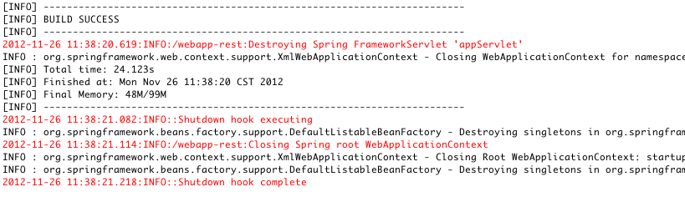
Interactive Demo Service Plugin
After running the clean install command your output should look something like this:
Notes:
Right click on the project folder and choose Maven => Clean
When complete, right click again and choose Maven => Install

Slide 155
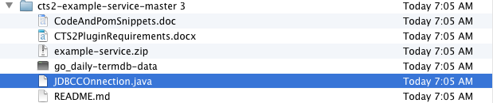
Interactive Demo Service Plugin
Connecting to a unique source.
Copy the JDBConnnector.java file to the edu.mayo.cts2.framework.plugin.service.example folder of the example-service
Notes:
From the cts2-example-service zip, get the JDBCConnection.java file and place it in the source folder.

Slide 156
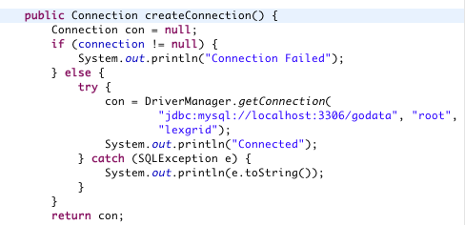
Interactive Demo Service Plugin
Adjust the hard coded connection properties to your local MySQL installation.
Notes:
Name, password and URL should reflect local settings.

Slide 157
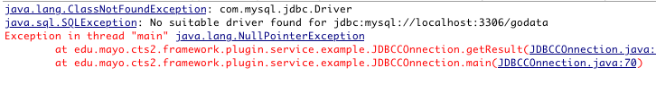
Interactive Demo Service Plugin
Running the main method we see we need a JDBC driver class.
Notes:
If you run the main class here it will fail. Pull in a connector with adjustments to the pom file.

Slide 158
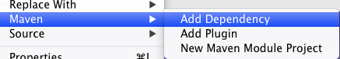
Interactive Demo Service Plugin
Using Eclipse as our example we’ll add a dependency to the pom.xml file:
Notes:
Right click on the project and choose Maven => Add Dependency

Slide 159
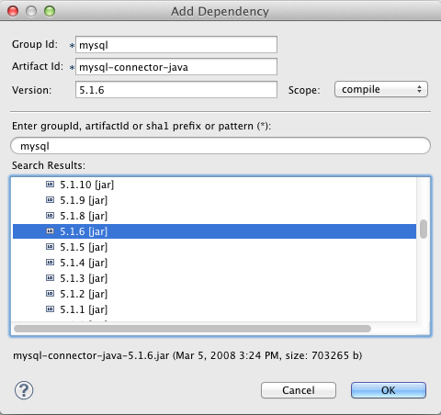
Interactive Demo Service Plugin
Add the MySQL connector version 5.1.6 to the pom file:
Notes:
Type mysql into the Enter group id field and the dependency wizard will automatically search for mysql related dependencies. Scroll down to the mysql-connector-java and open the folder to expose all available versions. Choose 5.1.6 and press OK.

Slide 160
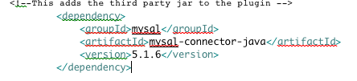
Interactive Demo Service Plugin
Alternatively you can cut and paste from the CodeAndPomSnippets file:
Notes:
Cut and paste into the the <dependencies> tag

Slide 161
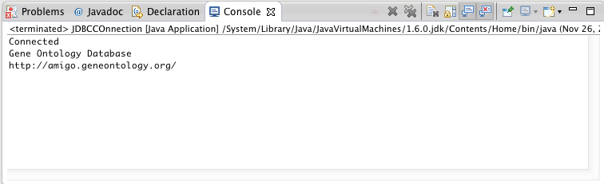
Interactive Demo Service Plugin
Running the main method against the “godata” database should give you output like this:
Notes:
Run the main class in the JDBC connector again and it should give you metadata about the GO ontology.
----- Meeting Notes (1/4/13 15:42) -----
You may need to run maven update at this point.
----- Meeting Notes (1/7/13 16:08) -----
Stop and check on progress

Slide 162
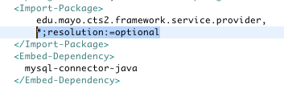
Interactive Demo Service Plugin
This gives us local runtime access to the connector – Let’s add it to the build using the OSGI bundling plugin (maven-bundle-plugin) and leave the other dependencies unresolved. We do this by adding it to the pom file:
Notes:
Now we want to add this to the build.
Using additions to the pom file we'll add the connector to a maven build.
Update this inside the instructions tag
Save the pom file and do a clean install sequence
----- Meeting Notes (1/4/13 15:42) -----
run maven update

Slide 163
Interactive Demo Service Plugin
The current mapping of the CTS2 CodeSystemCatalogEntry object is hardcoded
Change that to a dynamic method:
Copy and paste over the entire read method with the snippet from the CodeAndPomSnippet’s file
This runs a query against the database depending upon the abbreviated name of a code system
Run the Maven clean and install methods

Slide 164
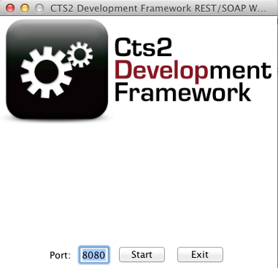
Interactive Demo Service Plugin
Start the standalone server:
Notes:
From whatever directory you choose to install the cts2 framework standalone server start the service by executing the jar file from java, then pushing the start button.

Slide 165
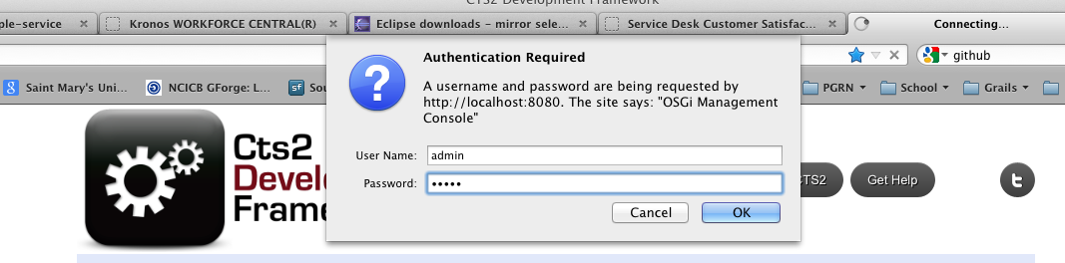
Interactive Demo Service Plugin
Click on the Admin Console button on the resulting web page:
Login using admin/admin.
Notes:
And login as admin/admin

Slide 166
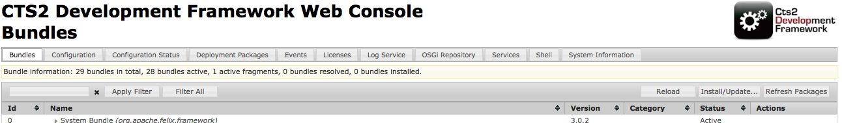
Interactive Demo: Service Plugin Import Plugin to Framework
Click on install/update
Notes:
Choose install update from the bar at the top of the list of plugins.

Slide 167
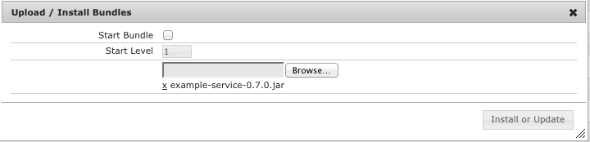
Interactive Demo: Service Plugin Import Plugin to Framework
Upload the jar
Notes:
Browse to the jar constructed in the maven build target folder

Slide 168

Interactive Demo: Service Plugin Import Plugin to Framework

Slide 169
Interactive Demo: Service Plugin Import Plugin to Framework
If necessary start the plugin:
Notes:
Refresh the browser
Click the play/stop button next to the example service plugin.
Go back and actually start the server and upload the jar.

Slide 170
Interactive Demo: Service Plugin Import Plugin to Framework
Create a REST call in a browser address bar:
Notes:
Type localhost:8080/codesystem/GO
Try also HUGO, KEGG

Slide 171

Interactive Demo Service Plugin
Expected Results

Slide 172
Interactive Demo Service Plugin
What have we learned:
What class needs to be extended to create a plugin class
How to create a mapping from a source to a CTS2 compatible element
How to import third party software into the OSGI bundling system using maven
How to run the CTS2 Development Framework Standalone server and upload a plugin to it

Slide 173
References
Sample REST calls for Module Specifications:
http://www.bioontology.org/wiki/index.php/CTS2_BioPortal_wrapper_summary
Sample REST calls for Module Specifications against an RDF triple store:
http://www.bioontology.org/wiki/index.php/CTS2_RDF_Plugin
REST interfaces for CTS2:
http://informatics.mayo.edu/cts2/index.php/REST
Service Plugin resources:
https://github.com/hsbauer/cts2-example-service/archive/master.zip
http://informatics.mayo.edu/cts2/framework/downloads/cts2framework-standalone.jar
http://www.mysql.com/downloads/mysql/5.1.html
http://maven.apache.org/download.html (Maven 2.2.1)
http://www.eclipse.org/downloads/

Slide 174
References
BioPortal REST Wrapper
http://informatics.mayo.edu/cts2/rest/valuesets
BioPortal RDF Wrapper
http://informatics.mayo.edu/cts2/services/bioportal-rdf/valuesets
BioPortal SPARQL endpoint:
http://sparql.bioontology.org/
MU Quality Measure Value Set Service
https://informatics.mayo.edu/cts2/services/mat/valuesets
GUIs that display CTS2 Content:
https://informatics.mayo.edu/vsmc
http://www.phenotypeportal.org/
UI Widgets Example:
http://informatics.mayo.edu/cts2widgets/widgets.html

Slide 175
References
UI Widgets in GitHub:
https://github.com/cts2/
https://github.com/cts2/cts2autocomplete
https://github.com/cts2/cts2tooltip
https://github.com/cts2/cts2dropdown
jQuery UI Widget Reference:
http://jqueryui.com/
JSFiddle UI Widgets Lab Exercises:
Tooltip: http://jsfiddle.net/coryendle/n9bWF/
Autocomplete: http://jsfiddle.net/coryendle/dKjXs/
Dropdown: http://jsfiddle.net/coryendle/bhTaD/

Slide 176
Questions & Discussion

